Slide 1
East London IDZ
DC & SUPPORTING INFRASTRUCTURE 2023 – TENDER BRIEFING SESSION
Reference No: RFP-ICT-085
06 December 2023

Slide 2
RFP Briefing Session Agenda
Housekeeping
Overview of the East London IDZ
  Who is the East London IDZ
RFP Overview and General Information
  Scope of Work
  Considerations
  Requirements
  Response Format
  RFP Completion Guidelines
  Handling of Questions
  ELIDZ Website
Procurement Guidelines
Question and Answer Session

Slide 3
Housekeeping
Meeting
Compulsory briefing meeting
Attendance Register
Capture company name, contact person, contact number and email address in the Q&A section.
Should you not capture them company represented is not signed in the briefing meeting.
Cellphones \ Microphone
Please silence your cellphone \ mute your microphone during the presentation
Handling of Questions During the Meeting
Type questions on the Q&A section
Handling of Questions Post Briefing Meeting
zandile@elidz.co.za

Slide 4
East London IDZ
ELIDZ Overview
Reference No: RFP-ICT-085
06 December 2023

Slide 5
Who is the East London IDZ?
State-owned company funded by the provincial Department of Economic Development and Environment Affairs and the national Department of Trade and Industry ( DTI).
The East London IDZ is governed by a board of directors representative of key stakeholders that are integral to the successful functioning of the organization.
The East London IDZ was designated in September 2002 and began its infrastructure development in 2003.
The first to receive an operator’s permit from the DTI.
The company is now in full operations.

Slide 6
East London IDZ
Project Scope
Reference No: RFP-ICT-085
06 December 2023

Slide 7
Scope of Work
The Scope Of This RFP Includes The Following:
The East London IDZ would like to appoint a service provider for the supply, installation and configuration of Schneider Electric data centre and supporting infrastructure with maintenance for a one-year period, unless otherwise specified.
The following areas are covered with a detailed scope and requirements in Section B, point 4.
General
  Basic Device Configurations
  Labelling and Asset Tagging
  Uptime Tier III Audits & Commissioning
  Packaging and Waste Disposal

Slide 8
Scope of Work
The Scope Of This RFP Includes The Following:
The following areas are covered with a detailed scope and requirements in Section B, point 4.
General
  Earthing
  Schneider Electric EcoStruxure Data Centre Infrastructure
  Corning Fiber Optic Infrastructure
  FiberGuide Infrastructure
  CISCO Network Infrastructure and Cabling
  Infrastructure Maintenance & Support
    Support Terms and Definitions
    Fault Logging & On-site Support

Slide 9
Scope of Work
The Scope Of This RFP Includes The Following:
The following areas are covered with a detailed scope and requirements in Section B, point 4.
General
  Reporting
  Skills Transfer, Processes & Documentation
  Project Management
  Travel and accommodation costs need to be included where applicable.

Slide 10
Scope of Work
The Scope Of This RFP Excludes The Following:
The following is excluded under this project:
Any infrastructure not listed in Section B, point 4 or procured after the commencement of this contract will be managed separately;
Fiber from the meet-me room to the existing zone blown fiber infrastructure as well as existing data centres.

Slide 11
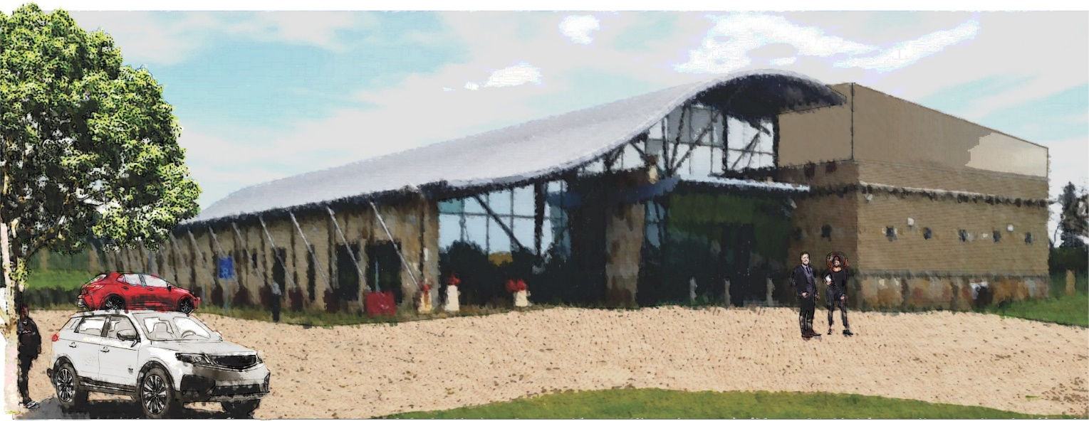
Stormwind Data Centre Overview

Slide 12
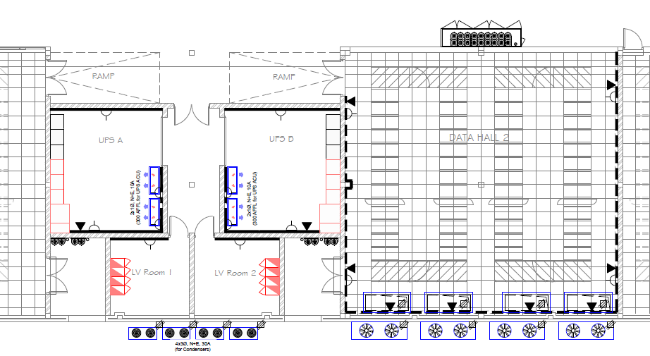
Stormwind Data Centre Overview

Slide 13
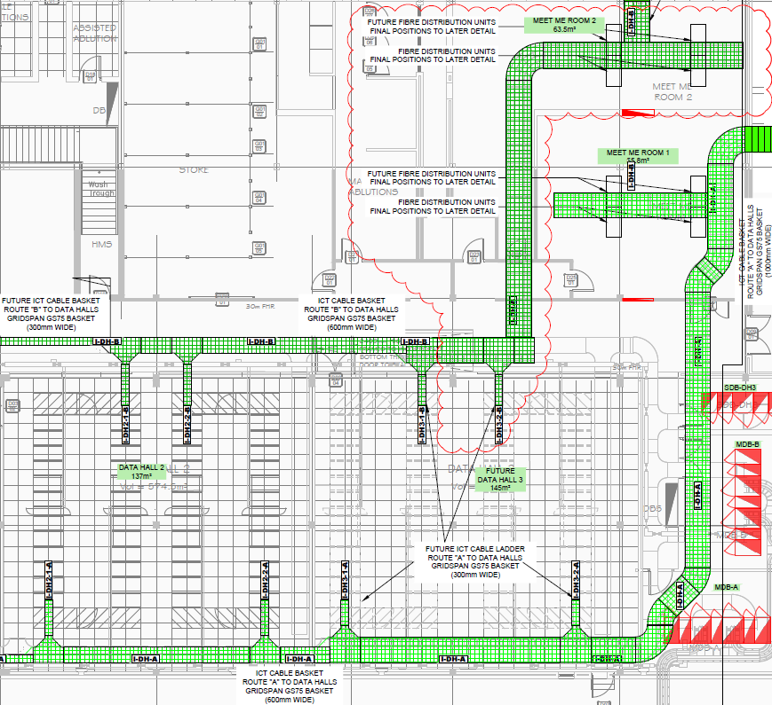
Stormwind Data Centre Overview

Slide 14
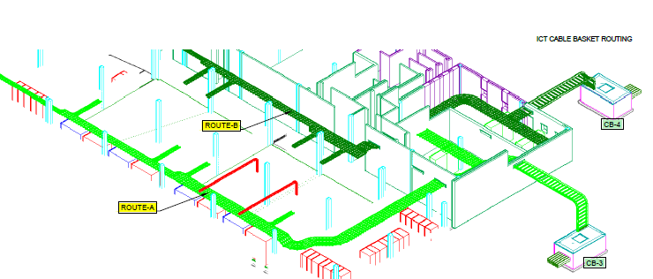
Stormwind Data Centre Overview

Slide 15
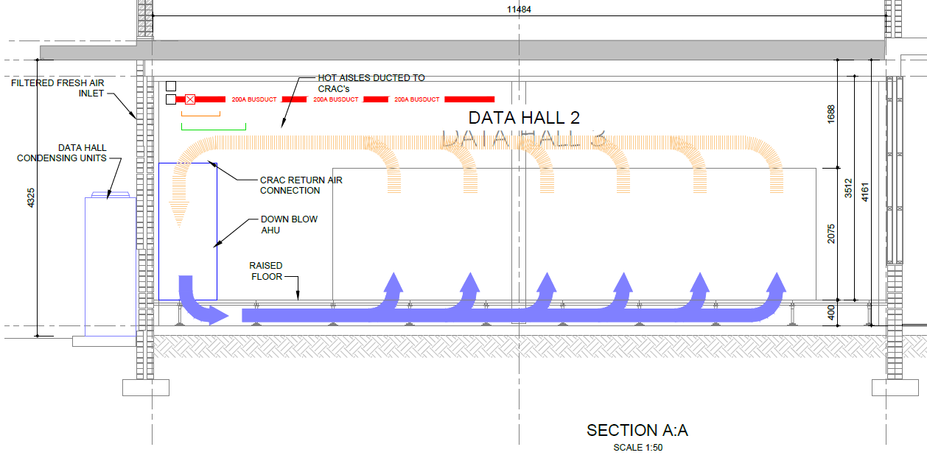
Stormwind Data Centre Overview

Slide 16
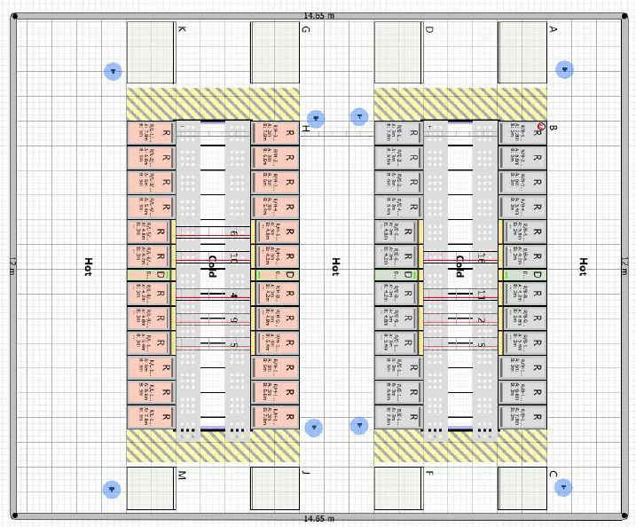
Stormwind Data Centre Overview

Slide 17
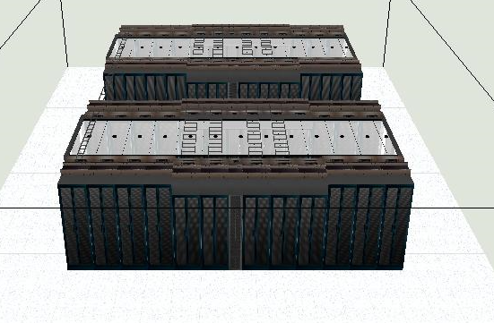
Stormwind Data Centre Overview

Slide 18
Stormwind Data Centre Overview

Slide 19
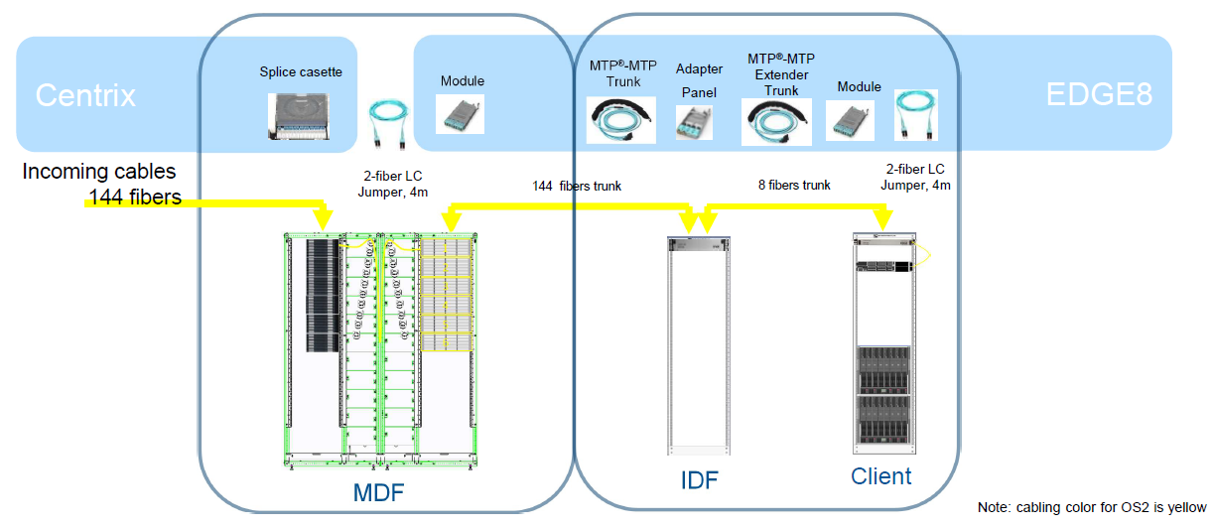
Stormwind Data Centre Overview

Slide 20
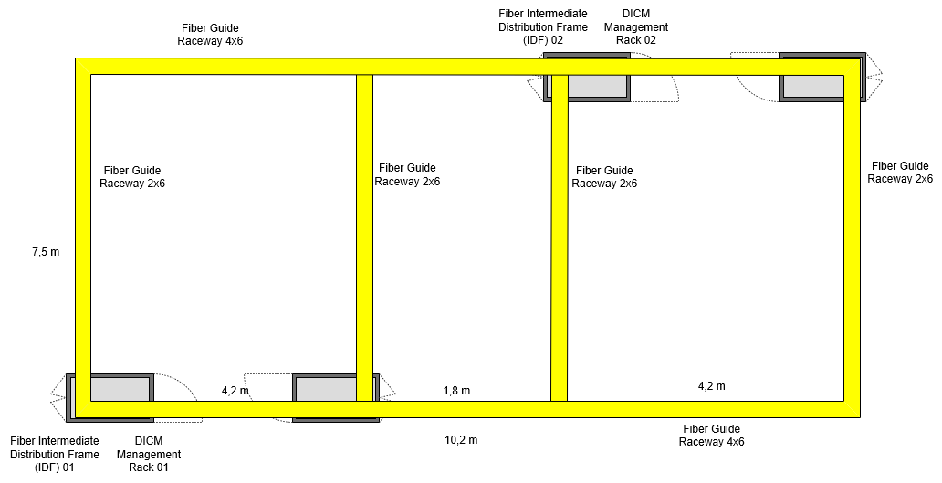
Stormwind Data Centre Overview

Slide 21
Functionality:
Evaluation Areas | Evaluation Criteria | Total Max Points | Item Max Points | Evaluation Description
Project Approach | Fault Logging | 20 | 20 | Evidence of a service desk provided for fault logging
 |  |  | 0 | No service desk provided for fault logging
 | Project Management | 15 | 15 | Draft project plan provided with milestones and timeline
 |  |  | 0 | No draft project plan provided

Slide 22
Functionality:
Evaluation Areas | Evaluation Criteria | Total Max Points | Item Max Points | Evaluation Description
Service Providers Expertise and Resources | Skills Competency | 25 | 25 | Project team members with relevant certifications in both Data Centre and Fiber technologies: Schneider Electric Cooling and Power field service certified, relevant specific SE Products and appropriate Structured Data Centre Fiber certifications
 |  |  | 20 | Project team members with relevant certifications in both Data Centre and Fiber technologies: Schneider Electric Cooling and Power field service certified and appropriate Structured Data Centre Fiber certifications
 |  |  | 0 | Project team members have no relevant certifications to support the project or only in one discipline

Slide 23
Functionality:
Evaluation Areas | Evaluation Criteria | Total Max Points | Item Max Points | Evaluation Description
Service Providers Expertise and Resources | Skills Competency | 20 | 20 | Project team members have an average of 10 years or more relevant working experience within the data centre power, cooling and structured data centre fibre disciplines relating to the above certifications
 |  |  | 10 | Project team members have an average of 5 years or more relevant working experience within the data centre power, cooling and structured data centre fibre disciplines related to the above certifications
 |  |  | 0 | Project team members have less than 5 years relevant working experience within the data centre power, cooling and structured data centre fibre disciplines relating to the above certifications

Slide 24
Functionality:
Evaluation Areas | Evaluation Criteria | Total Max Points | Item Max Points | Evaluation Description
Service Providers Expertise and Resources | References | 20 | 20 | 3 Relevant references provided on reference templates. This combined average score will then be translated to a final score out of 20.
 |  |  | 0 | Less than 3 relevant references provided

Slide 25
Considerations Continued
  Financial Considerations
Payment milestones will be attached to the service level agreement.
  Time Considerations
The East London Industrial Development Zone would like this project to commence as soon as possible after approval and the signing of the service level agreement.
  Area of Service & Facilities
The delivery of services will be required at the ELIDZ office, Lower Chester Road, Sunnyridge, East London.
Onsite storage and office space will be made available if and when required.
Delivery of the equipment to our new data centre needs to be aligned with either sectional completion or handover of the entire site. The renovation of the new data centre is expected to be completed by the end of January 2023.

Slide 26
Considerations Continued
Time Constraints
The ELIDZ envisages the following delivery timelines for the project:
Milestones Target Date
Advert and Issuing of RFP : 24th November 2023
Compulsory Briefing Session : 10h00, 07th December 2023
Deadline for Questions : 16h00, 15th January 2024
Response to Questions : 16h00, 16th January 2024
RFP Submission Due Date : 12h00, 22nd January 2024

Slide 27
Considerations Continued
Project Team Skills Matrix Example
Where a third-party assists the appointed service provider with a portion of the defined deliverables, clearly indicate the scope of the third-party as well as include their relevant skills \ qualifications and years of work experience relevant to this project for the associated personnel.
Team Member | Company | Qualifications \ Disciplines | Years of Experience
Joe Soap | Company ABC | Cooling Field Service Engineer | 8 Years
Joe Bloggs | Company ABC | Power Filed Service Engineer | 5 Years
Joe Sixpack | Schneider Electric | DCIM Engineer | 13 Years
Average Years of Experience |  |  | 8,6 Years

Slide 28
Method of Submission
Tenders must be submitted on-line on the on the ELIDZ website at http://www.elidz.co.za - https://tenderportal.elidz.co.za - under Opportunities Tenders.
It will be the responsibility of the tenderer to ensure that the tender documentation are uploaded before 12h00 on the 22nd January November 2024.
Tenderers must submit technical proposal “Envelope A” separate from financial proposal “Envelope B”.
No financial disclosure must not be included in the technical proposal “Envelope A”
The financial proposal will only be opened should the technical proposal be found to be acceptable.
The Envelope A – Technical Proposal:
  Must include numbered or alphabetized section dividers and a contents page that indicates the numbered or alphabetized section names.
  Above-mentioned sections to align to documents listed in the above tables articulating the Supporting and Compulsory documentation to be submitted.
  Ensure the all the documents are property scanned before uploaded and in corrector format prior submission.

Slide 29
Response Format : Supporting Documentation to be Submitted
CIPC Registration
Share certificate
Proof of disability
Accredited Valid Original or Certified B-BBEE Certificate for EMES and QSE - Sworn Affidavit confirming annual turnover and B-BEE management split of company
Proof of Office Location (lease agreement, statement of account, from the municipality and/or confirmation of address/clearance from the municipal councilor)
Company Profile
Proposed Solution and Project Approach
Project Team Skills Matrix and Curriculum Vitae’s
Three (3) Completed and Verifiable Reference Letters for similar work (Annexure 2)
Supplier Development Plan (If applicable)

Slide 30
Response Format : Compulsory Documentation to be Submitted
Completed and Signed ELIDZ Procurement Handbook with all relevant supporting documentation (Tax clearance etc.)
CSD Registration Certificate
JV Participation Documentation with consolidated BBBEE (If applicable)

Slide 31
Handling of Questions
Questions relating to the RFQ will be accepted via email.
Questions relating to the RFP will be accepted until 16h00 on 15th January 2024.
All questions will be noted, responded to via email and circulated to all respondents no later than 16:00 16th January 2023.
Please ensure the company represented is signed inn by capturing company name, contract person, contract number and email address in the Q&A section.
All questions must be submitted to:
  Zandile Mtebele
  Email: Zandile@elidz.co.za
  All questions should be in writing
  Verbal question shall not be accepted

Slide 32
ELIDZ Website – Tender Opportunities
Full Tender Advert & Documents
The full tender advert is available on the ELIDZ website at http://www.elidz.co.za
Tenders are posted under Opportunities Tenders
An electronic version of Envelope A & B, ELIDZ Procumbent Handbook and the Reference Letter Template can also be found at the same location.

Slide 33
East London IDZ
Procurement Guidelines
Reference No: RFP-ICT-085
06 December 2023

Slide 34
Procurement Guidelines
Purpose
  Procurement Policy
  Two-Envelope Method
Evaluation Criteria 70%
  Functionality – (All tenders with functionality less than 70% of the total functional requirements will not be considered.)
Preference Points 80/20 or 90/10
  80 Points for Price
  20 Points for BBBEE

Slide 35
Procurement Guidelines
Technical Submission (Envelope A)
Completion of Procurement Forms
  Completion of all sections of Procurement Handbook, inclusive of Disclosure of Interests page (Compulsory).
  Submission of B-BBEE Certification and/or Sworn affidavit as outlined in the B-BBEE Act/ original/Certified copy
  Valid SARS TAX clearance Certificate/Pin code
  CSD Registration
  Documents listed under RETURNABLE SCHEDULES/DOCUMENTS must be submitted with Envelope A
  Inclusion of Price or any price details in Envelope A ‘Technical Proposal ‘ will result in disqualification of the tender

Slide 36
Procurement Guidelines
  Completion of Price Proposal Schedule (Envelope B)
  Non-Completion of the ELIDZ Price Proposal Schedule in Envelope B “Financial Proposal” will result in disqualification.
  Total Price should include the provisional amount provided
  Price Schedule (figures vs. words & signatures).
  Non signed Price Schedule will result in disqualification of bid offer.

Slide 37
Price Schedule
Description | Qty | Amount ( R )
Schneider Electric EcoStruxure Data Centre Infrastructure | 1
Corning Fiber Optic Infrastructure | 1
FiberGuide Infrastructure | 1
CISCO Network Infrastructure and Cabling | 1
Infrastructure Maintenance & Support | 1
Tier III Commissioning & Load Banks | 1
Sundries | 1
Project Management \ Professional Services | 1
 | Amount ( R )
Total
VAT @ 15%
Total (Including VAT)

Slide 38
Procurement Guidelines
  Envelope Submission:
Tenders must be submitted on-line on the on the ELIDZ website at http://www.elidz.co.za - https://tenderportal.elidz.co.za - under Opportunities Tenders.
  Joint Venture Submission
  JV Document Submissions (e.g. Tax Clearance, Consolidated B-BBEE Certificates, Business Reg. etc.)
  JV Participation Split (%) and signed Agreement

Slide 39
Procurement Guidelines
Evaluation of Tenders (Adjudication Structures)
Internal Evaluation Committee conducts tender evaluations
(may invite experts from outside)
Adjudication: based on financial delegations
Adjudicating Structures
Procurement Committee
Finance & Tender Committee of the Board
Board of Directors
Award
Letter of Appointment
Signing of Service Level Agreement
Supplier Development
In the event that the successful Bidder has been awarded the contract with value above
R 5 000 000.00 for the same goods/services on a consecutive basis, the successful Bidder will be required to submit a Supplier development plan for SMMEs to be agreed with the ELIDZ

Slide 40
East London IDZ
Question and Answer Session
Reference No: RFP-ICT-085
06 December 2023

